Slide 1
Global Canopy Height dataset with geological factors and tabular model fine tuned on this data

Slide 2
Introduction and Aim
In this project we aim to create a global canopy height dataset and find correlations of it with other geological factors like min/max temperature, precipitation, evapotranspiration etc.
With the help of this dataset we can fine tune a model , and with the help of this model we can predict canopy heights of previous years with the help of geological factors available. As no other reliable source of canopy height data is available.
With canopy height data of previous years available we can observe trends and analyse the reasons for the trends.

Slide 3
Motivation
Make the first ever time varying data of canopy height using GEDI scanner.
Estimating the carbon stored on land on global scale, thus helping us to accurately quantify the carbon dioxide being eaten by the land. This is a very important component for global carbon cycle and is a missing link in the climate change computations.
A second use of this data would be within the numerical weather prediction models to enable them in performing yield/crop forecasts. This is still absent in the present systems.
Such an algorithm enabling us to estimate crop heights will help in real time agricultural monitoring. For example, over a field if the farmers grow similar/same crops every year and for a particular year if we get an anomalously low crop height, the government can step in to help farmers of that region by artificial rain or offering them pesticides if their region is infected

Slide 4
Methodology
We processed the canopy height data of 2019-2020 made available by a research conducted by ETH Zurich scientist, gathered through LIDAR scanner and Sentinel images.
Then, combined it with terra climate dataset which contained min/max temp, evapotranspiration, precipitation etc. of the same time.
After the dataset was completed, Autogluon was used on the tabular dataset to obtain a weighted ensemble model.

Slide 5
Results
Our model succeeded any past attempts on creating a robust model which could accurately predict canopy height with other geological factors.
Scores on testing dataset:-
{'mean_absolute_error': -0.8935100460770993, 'root_mean_squared_error': -2.0250480183219848, 'mean_squared_error': -4.100819476509797, 'r2': 0.9234912347835005, 'pearsonr': 0.9609853669051123, 'median_absolute_error': -8.709394023753703e-05}

Slide 6
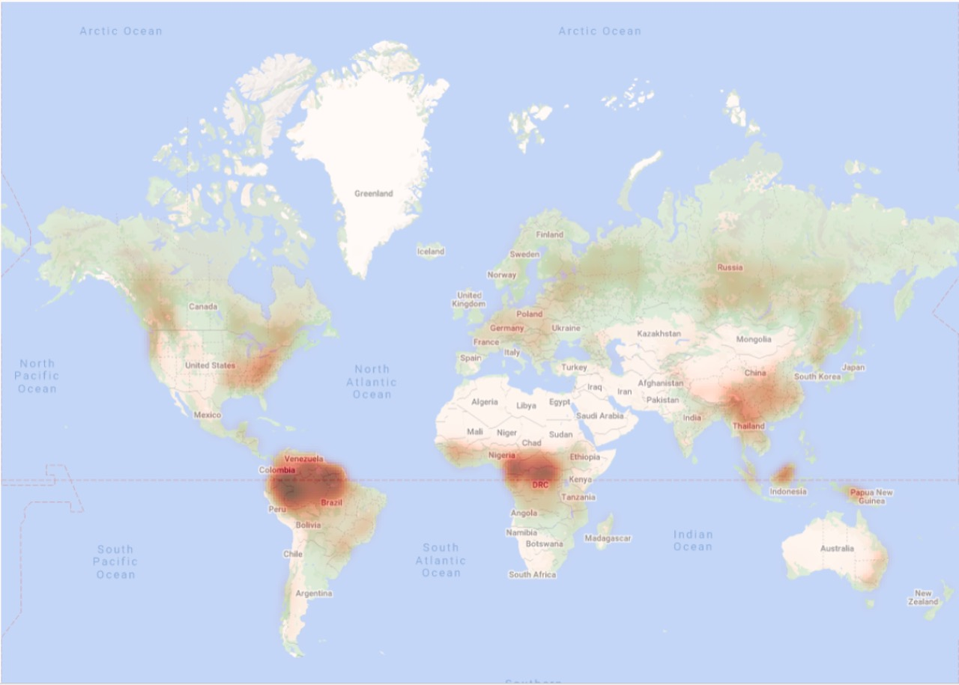
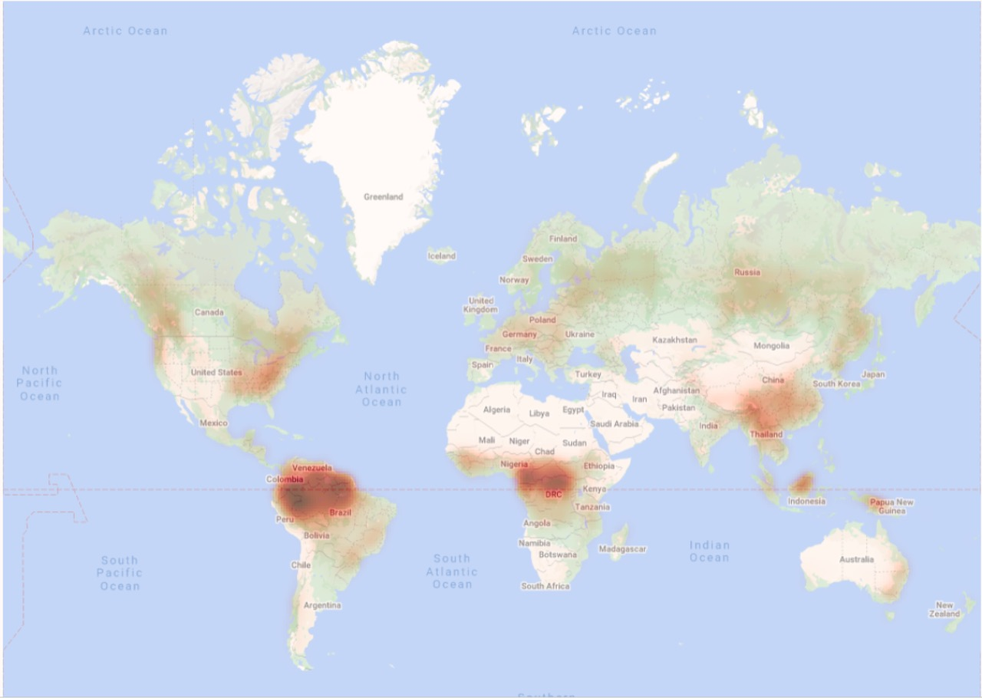
Original Predicted

